Slide 1
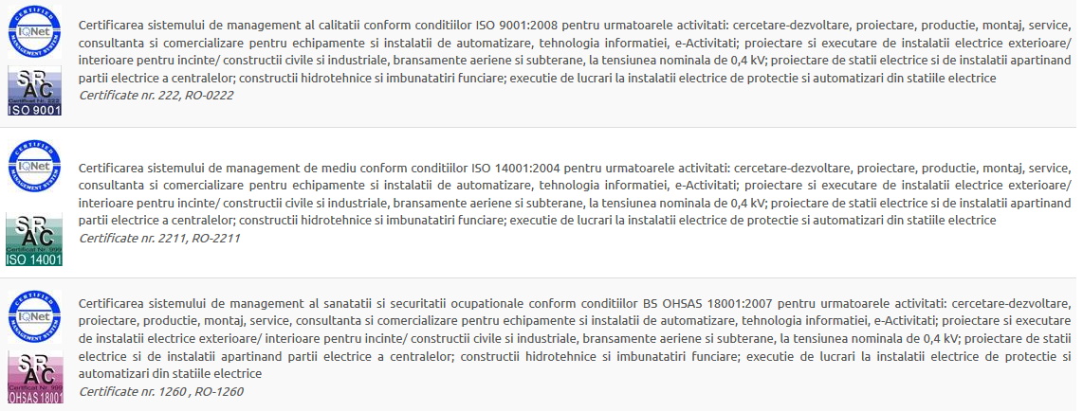
CERTIFICARI - 1/4

Slide 2
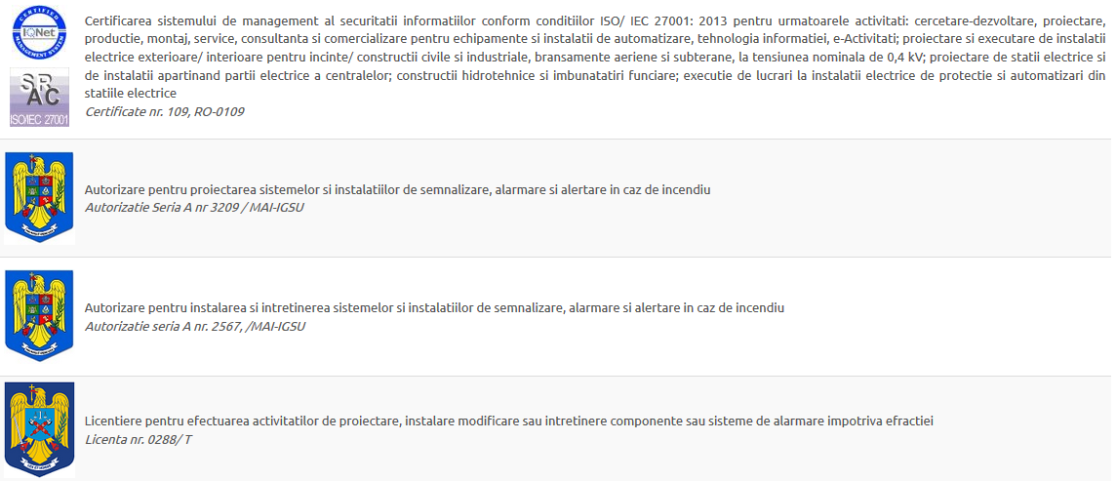
CERTIFICARI - 2/4

Slide 3
CERTIFICARI - 3/4

Slide 4
CERTIFICARI - 4/4

